Slide 1
Estimation
Day 3
2016

Slide 2
Contents
What is Statistical Inference?
Sampling Distribution of the Mean
Point and Interval Estimation
Introduction to Confidence Intervals
Confidence Intervals
  when the population standard deviation is known
  when the population standard deviation is unknown
Confidence interval for a population proportion

Slide 3
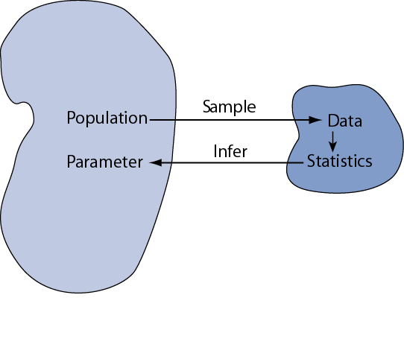
Statistical inference is the act of generalizing from a sample to a population with calculated degree of certainty
We want to learn about the population parameters…
…but we can only calculate sample statistics
µ
Notes:
Relate back to the end of the previous session
Idea of statistics is to understand something about the population, but we don’t know about the population
Take a sample and infer about the population
We understand parameters such as mean, std. deviation, etc.
Example – How much do new joinees spend on a monthly basis?

Slide 4
Statistical inference two steps – estimation and testing of hypothesis
Inference
Estimation
Testing of Hypothesis
Point Estimation
Interval Estimation
 | Parameters | Statistics
Source | Population | Sample
Calculated? | No | Yes
Constants? | Yes | No
Examples | μ, σ, p
Notes:
Ask a question – How would you estimate how much a cricket/ basketball player scores in match? [point vs. interval estimate]
Running estimate based on past observations
Statistics is mostly about inference [decision making under uncertainty]
Just saying 20,000 is point estimation, 15-20K is an interval estimate [New joinee example]
There is a certainty around the interval estimate
Just calculating an average on a sample is a point estimate [of the true population parameter]
There is a skepticism in scientific research on new claims made. How can the person making the claim convince the rest? Need evidence to support the claim

Slide 5
It is not enough just to estimate the parameter – one also needs to estimate the error to get a sense of certainty
How precisely does a given sample mean (x-bar) reflect underlying population mean (μ)? How reliable are our inferences?
What is the chance that I am observing this sample by fluke
The standard error of the sample mean is the standard deviation of the sample mean’s estimate of the population mean
Notes:
Continue with the income of new joinees example
Since we don’t have knowledge about the population, we use the sample mean and sample std. deviation
Give examples of business:
Running a multi-million dollar campaign?
How much certainty/ confidence/ risk is associated with it? [Discuss why I would be more comfortable with an interval estimate with a certain confidence, vs. a point estimate?]
Ask if they would make such a decision?
Discuss some more examples of the implications of the risk

Slide 6
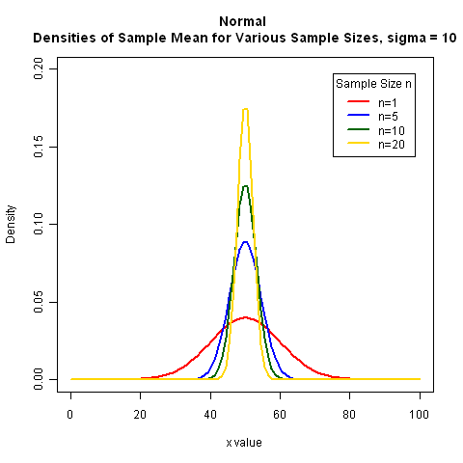
Drawing inference from the samples
To draw inference from the samples, we need to compute some appropriate numbers from the random sample
To draw inference about the mean of the population (μ), we compute the sample mean
The distribution of is called the sampling distribution of the sample mean
The sampling distribution is the basis of making inferences
For instance if , then
As sample size increases the sample mean is subject to less and less variation
Notes:
Have a brief recap on the Central Limit Theorem [Use the white board for this]
If X follows a normal distribution, what distribution does xbar follow?
Simulation on how the std. deviation of the sampling distribution of the sample mean is sigma^2/n
Ask the question about what they observe about the sampling distribution?
If n increases, what happens? What does this mean?

Slide 7
Estimate of population mean and its standard error
The unknown population mean is μ is estimated by x̄
However estimate of population mean, is not always enough. We need to know how good this estimate is, i.e., on an average how much is my sample mean (x̄) is going to vary
An estimate of this standard deviation is given by
However, σ is not generally known, and it is estimated by the variance of the sample denoted by s
The expression, is called the standard error of the estimate x̄
From the theory of sampling distributions, we have, if x̄ ~ N(μ, σ²),
and
(t – distribution with (n-1) degrees of freedom)
Notes:
Go through the standardization of x and xbar
Talk about sample standard deviation. Why n-1? [Use a simulation for this]
What is a t-distribution in relation to a normal distribution. For larger sample sizes, they overlap
N-1 DOF (Mean is fixed)

Slide 8
A confidence interval estimate provides more information about the population parameter than a point estimate
A point estimate is just a single number – we are unaware of any kind uncertainty that may be associated with it
A confidence interval estimate gives a range or an interval along with an associated level of confidence
Upper
Confidence
Limit
Lower
Confidence
Limit
Point Estimate
Width of
confidence interval
Notes:
http://treasure.diylol.com/uploads/post/image/516333/resized_winter-is-coming-meme-generator-brace-yourselves-confidence-intervals-are-coming-e99ce6.jpg (Add this image depending on how they seem to respond in the initial two days)
The level of confidence in a confidence interval is a probability that represents the percentage of intervals that will contain if a large number of repeated samples are obtained

Slide 9
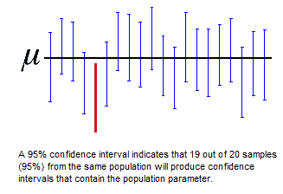
Factors that may affect confidence intervals
Width of the confidence intervals are determined by three factors
  The sample size n
  The variability in the population, usually σ or s
  The desired level of confidence
For a 95% confidence interval about 95% of the similarly constructed intervals will contain the population parameter being estimated
Notes:
Here, the horizontal black line represents the fixed value of the unknown population mean, µ. The vertical blue confidence intervals that overlap the horizontal line contain the value of the population mean. The red confidence interval that is completely below the horizontal line does not
What does a confidence interval mean?
It is not 95% confidence that the population mean lies in the specific interval? What is the probability of this? [either 0 or 1] Either lies in it or doesn’t. Show an example on the board.
Relate back to frequentist definition of probability
Illustrate on white board taking multiple samples and calculating confidence interval
Trade-off between width of interval and confidence for the sample size
What is the effect of sample size on the interval? More is better.
Take some more examples:
Roosevelt example
It’s about choosing the sample in the right way [process of sampling]
Why do we use the sampling distribution to understand the uncertainty of the estimate?
We want to understand the uncertainty associated with sampling by fluke
The sampling distribution of sample means shows the entire distribution of sample means [This result comes from CLT. You will never repeatedly sample]
Looking at my sample mean in that distribution gives me a measure of the uncertainty.
http://support.minitab.com/en-us/minitab/17/topic-library/basic-statistics-and-graphs/introductory-concepts/confidence-interval/confidence-interval/
Repeated sampling simulation example

Slide 10
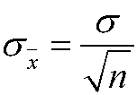
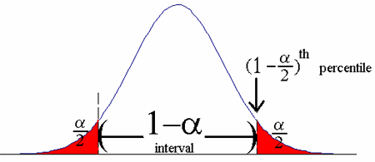
Confidence Intervals for an unknown population mean and known variance
The construction of a confidence interval for the population mean depends upon
  The point estimate of the population
  The level of confidence
  The standard deviation of the sample mean
Because the sample mean is normally distributed, we know that 95% of all sample means should lie within 1.96 standard deviations of the population mean and 2.5% will lie in each tail
Notes:
Use this illustration to show what a 95% confidence interval looks like
P(L<(Xbar –Mu)/Sigma<U) = 0.95
Use any of the simulations below
http://onlinestatbook.com/stat_sim/conf_interval/index.html
http://statweb.calpoly.edu/chance/applets/Reeses/ReesesPieces.html
http://demonstrations.wolfram.com/ConfidenceIntervalsConfidenceLevelSampleSizeAndMarginOfError/

Slide 11
Confidence interval is only a random interval as the end points of the interval are random variables
A correct way to interpret confidence interval is – “if an infinite number of random samples are collected, and a 100(1 - α)% confidence interval for μ is computed from each sample, 100(1 – α)% of these intervals will contain the true value of μ”
In practice we obtain only one random sample and calculate one confidence interval
Since this interval either will or will not contain the true value of μ it is not reasonable to attach a probability level to this specific event

Slide 12



Confidence interval will vary based on the sample obtained
A confidence interval estimate for μ is an interval of the form L ≤ μ ≤ U such that,
Since Z follows a standard normal distribution, we have
Manipulating the quantities inside the probability expression, we get
Notes:
Continue with the derivation of confidence intervals.
Relate back to the normal distribution discussion. [95% values within 1.96 std deviations]
Derivation of confidence intervals - http://dsearls.org/courses/M120Concepts/ClassNotes/Statistics/530G_Derivation.htm
C

Slide 13
Confidence Intervals for an unknown population mean and unknown variance
Confidence interval for mean where σ is unknown is given by
It follows Student’s t-distribution with n-1 degrees of freedom
The area in the tails of the t distribution is a little greater than the area in the tails of the standard normal distribution. This result is because we are using s as an estimate of which introduces more variability to the t statistic
As the sample size increases, however, the t distribution approaches the standard normal distribution,
Notes:
The area in the tails of the t distribution is a little greater than the area in the tails of the standard normal distribution. This result is because we are using s as an estimate of which introduces more variability to the t statistic
As the sample size increases, however, the t distribution approaches the standard normal distribution,

Slide 14
Confidence Interval for the Mean – Example using the t-distribution
A tire manufacturer wishes to investigate the tread life of its tires. A sample of 10 tires driven 50,000 miles revealed a sample mean of 0.32 inch of tread remaining with a standard deviation of 0.09 inch. Construct a 95 percent confidence interval for the population mean. Would it be reasonable for the manufacturer to conclude that after 50,000 miles the population mean amount of tread remaining is 0.30 inches?
Notes:
Use Excel formulae to understand how to get t values and z values

Slide 15
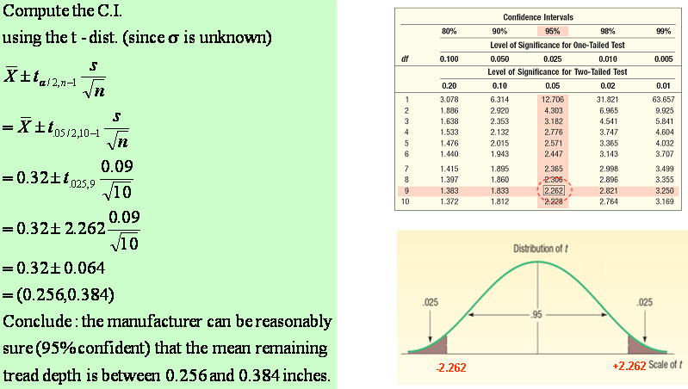
Student’s t-distribution Table
14
Notes:
Can’t have tables for all possible distributions – In the days before computers.

Slide 16


Confidence Interval Estimates for the Mean – Example
The manager of the Inlet Square Mall, near Ft. Myers, Florida, wants to estimate the mean amount spent per shopping visit by customers.
A sample of 20 customers reveals the following amounts spent.
15

Slide 17
Confidence Interval Estimates for the Mean – By Formula

Slide 18
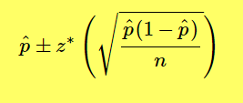
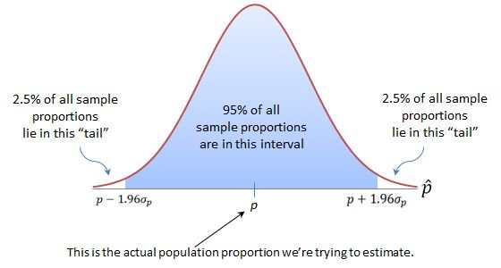
Confidence Interval for a Population Proportion
A confidence interval for a population proportion is constructed by taking the point estimate (pˆp^) plus and minus the margin of error. The margin of error is computed by multiplying a z multiplier by the standard error, SE(pˆ).
Notes:
P(1-P) is the variance of the binomial distribution – Intuition is the same

Slide 19
Confidence Interval for a Population Proportion - Example
The union representing the Bottle Blowers of America (BBA) is considering a proposal to merge with the Teamsters Union. According to BBA union bylaws, at least three-fourths of the union membership must approve any merger. A random sample of 2,000 current BBA members reveals 1,600 plan to vote for the merger proposal. What is the estimate of the population proportion?
Develop a 95 percent confidence interval for the population proportion. Basing your decision on this sample information, can you conclude that the necessary proportion of BBA members favor the merger? Why?

Slide 20

Confidence Interval
Notes:
Ask them to think of the consequences of increasing the interval to increase the confidence level

Slide 21
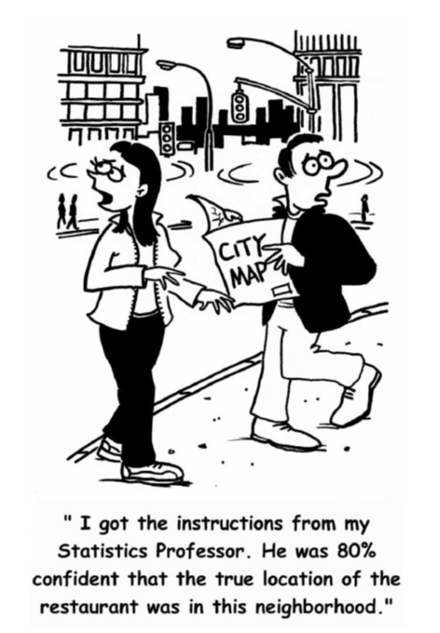
Confidence Intervals – What do they mean?

